Slide 1

DriverPass System Analysis
Provided by: Bradleyt Byard
Notes:
[No speaker notes required for this slide.]

Slide 2


System Requirements
Functional Requirements
Administration/IT updates
Authorization levels
Validate user credentials
Different user accounts per student to hold personal info (name, email, test scores, etc.)
System lockout in case of security attack
Non-functional Requirements
Material input and output will have an import/export section.
Simplicity of use and site layout
Links for different functions on site
Online message center for students and admin to communicate
Project System goal: Training students for their driving test at their local DMV
Notes:
Functional
Admin will be updating test and class material and keeping it up to date
Each user needs authorization to perform certain activities in the system.
Every student needs a personal account to log their test grades and their driving schedules and one they can log in and continue their personal testing. This info will be kept private to just them.
Non-Functional
Admin will be able to upload and download tests to take them home to grade
Student can upload and download material to work on offline also.
Online message center allows for communication between all users.
System should be designed so it’s easy for student to understand
Quick click buttons
Up to date layout
Common features other current systems use, etc.

Slide 3
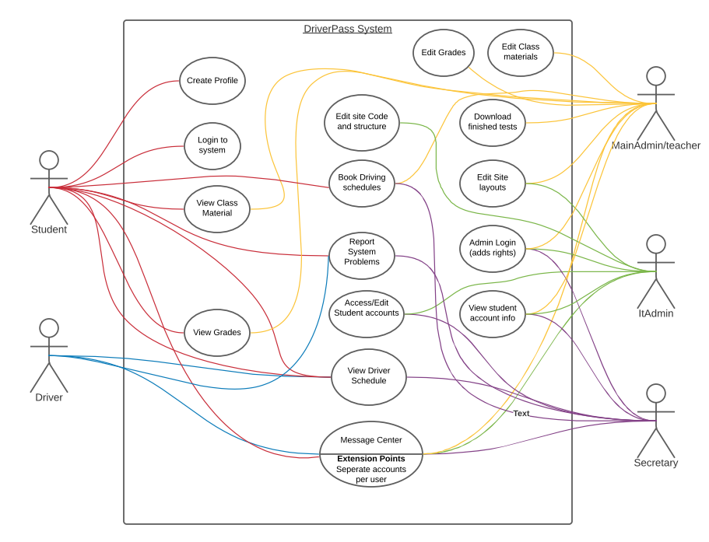
Use Case Diagram
This Use Case Diagram shows interactions between Users and the DriverPass system and how they relate to each other
Notes:
This Use Case Diagram shows interactions between Users and the DriverPass system and how they relate to each other. It shows 5 users of the system: Student, Driver, Teacher, IT, and secretary. The diagram is color coded to show what activity each user is doing in the system. This Diagram has activities discussed with DriverPass, which includes all the things the company has a vision for the system to be able to do.

Slide 4
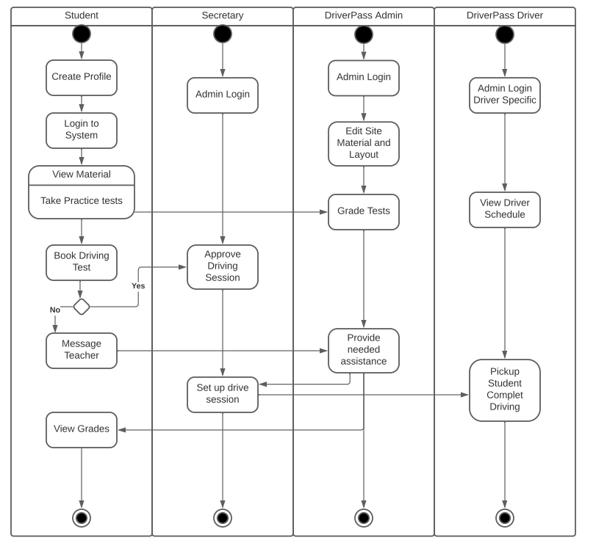
Activity Diagram
Notes:
This diagram breaks down each user’s activities and how they will fit into the system. It shows a list of possible events that each user is completing in the system. It also shows how they are interacting with the others at the same time. The student is the main user of the system (who it’s designed for) so you can see they complete the most activities. So In short this model goes through what a new user or student would do when they began using this system, and when they do, it shows how the other users will interact with them and what events they do while in the process. Starting on top of each user’s section you can just travel down to see what they would do and follow the arrows to see how those actions relate to other users.

Slide 5
Security
SECURITY
Each student user will require the following information when setting up account.
First name
Last name
Email
Password
Address
Phone number
Security questions (recovery option)
Upon each login will require
Email
Password
Upon forgot credentials system will require
A sent email, text to phone number, or answered security questions.
Upon a brute force hacking attempt or 5+ failed login attempts, system will lock out user (until admin is contacted).
Notes:
In todays world there is so many hackers and security breaches it is very important to use top notch security features in any software or online environment. Each user’s account has personal information so it has to be protected and we have to make sure that they are the only ones accessing their info. Each login by a student will require a username (email) and password. If they forget their password they can reset if via company Admin or additional ways such as security questions and recovery emails.
If password is entered wrong more than 5 times, user will be locked out until unlocked by admin.
With these methods each user will be protected.

Slide 6

System Limitations
Limitations
Only accessible for users via the web (professors/users can download material though)
Only useful on windows compatible
Could be upgraded to hand MAC and mobile, but this would be much more costly and I would recommend the windows/browser layout to start as it will be most efficient.
Notes:
Only mainly designed for windows setup. It could be used on other platforms but it makes most sense to implement on windows. The systems main functions will need web connection but to make this limitation better we are including an upload/download function where students can download tests and take them with no web connection, and then upload them later to be graded when they have a web connection again. In this same way the Admin can download and upload them grade and release them.

